Slide 1
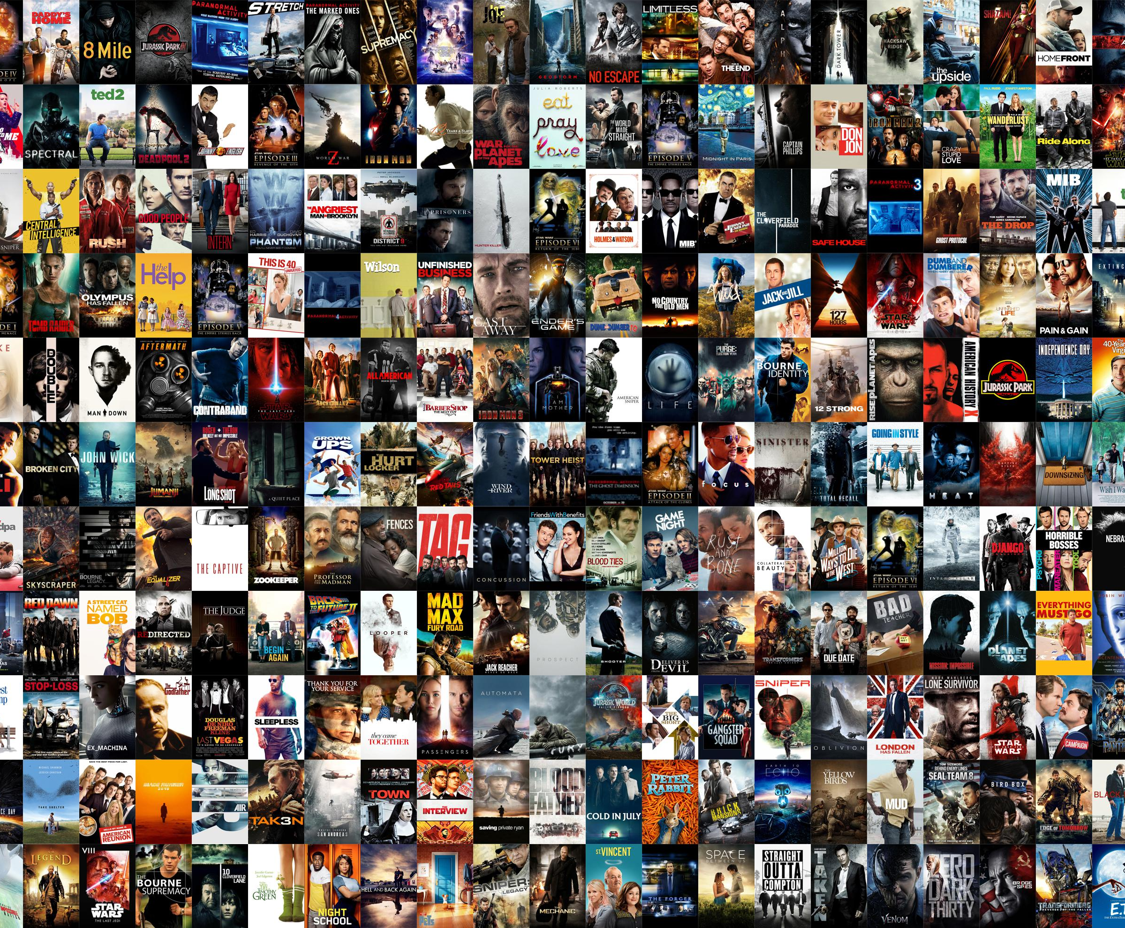

NETFLIX Movies/Shows Search
Team Members:
Irfan Ahmed
Srikanth Yelem
Divyanshi Kothari

Slide 2
Project Objective:
Movie and TV show recommendation by creating BOW of words from description, title, types, director, and cast. Here we are applying various models to determine which model could provide better results.
Irfan contribution to the project:
Creating BOW (using Rake)
Linear Kernel for recommendation
Creating Deep Learning Model using LSTM

Slide 3
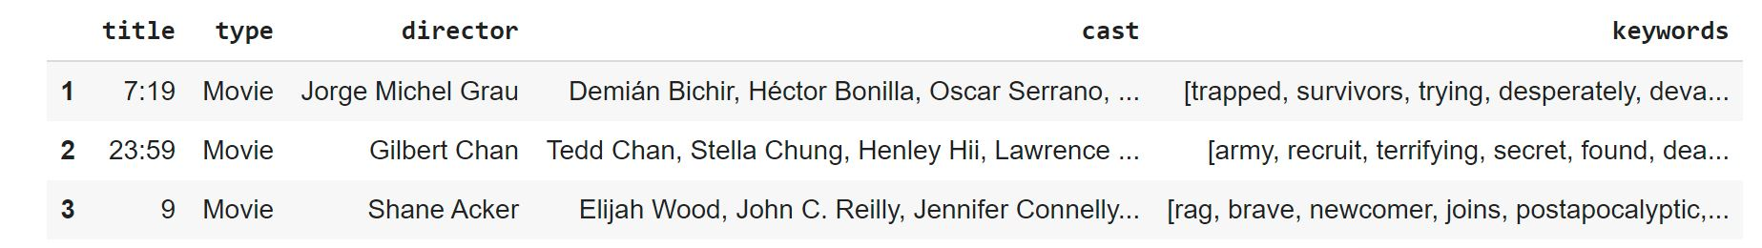
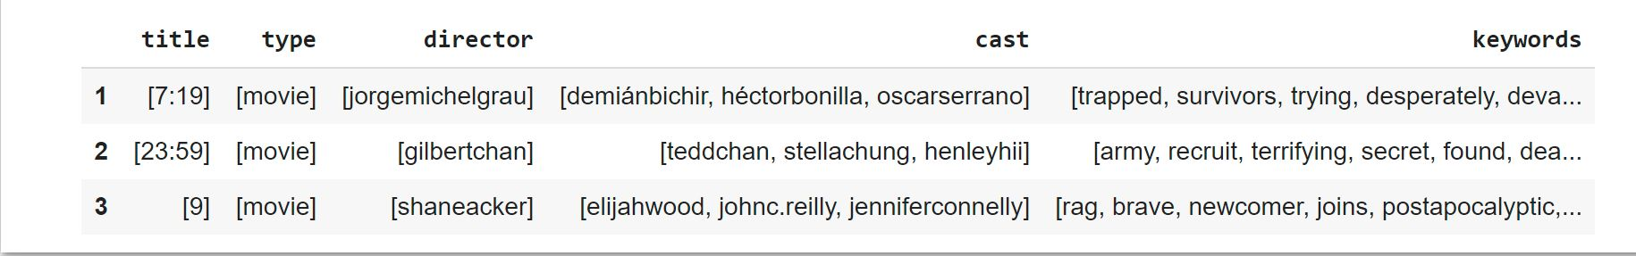
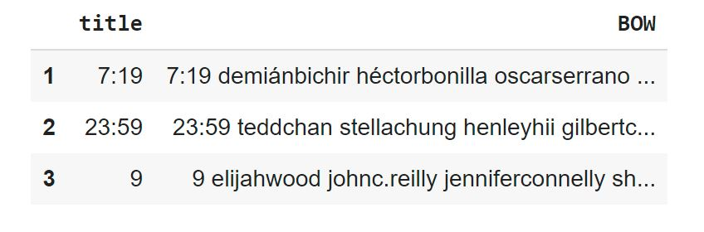
Rake: Rake Automatic Keyword Extraction
RAKE is keyword extraction algorithm. The algorithm uses stopwords and key phrases in a text/sentence to determine word frequency and its occurrence relating to other words in the document.
The Netflix dataset was used which was obtained from Kaggle:
For the purpose of this project only the title, type, director, cast, description columns were used.
For each of the description the keywords were extracted using rake and saved into a new column.
Then the other columns were mapped so they cold be combined with the keyword.

Slide 4
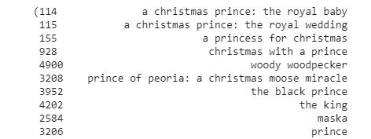
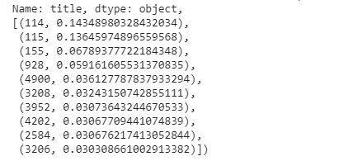
SVM Linear Kernel used for movie recommendation
Linear Kernel is used for linearly separable data using a line. This is often good to use when there are greater quantity of features in a dataset, such as text datasets.
The dataset created with RAKE was used to see if this method would improve the movie recommendations or not.

Slide 5
Keras model with LSTM layer
It a s feedforward artificial network.
Consists of three-layer nodes.
Input, hidden, output layer.
Consists of artificial neurons .
The units have weighted input signals and an activation function is used to produce an output.
The API style that I decided to use was Sequential Model:
- It is simple to use and great for 70% of the use cases.
For the complier optimizer ‘adam’ used used, and loss function ‘sparse_categorical_crossentropy’

Slide 6
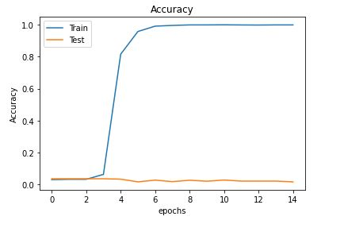
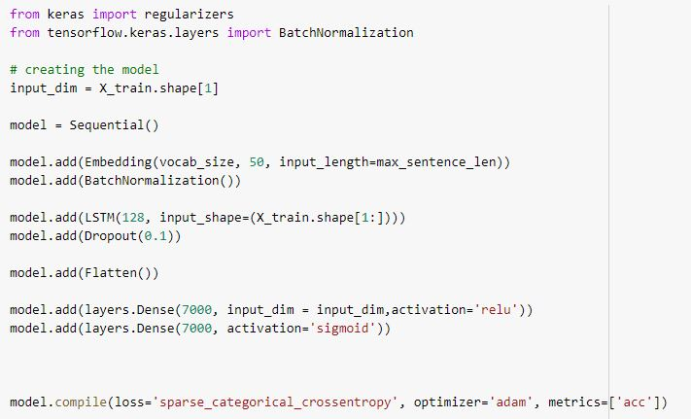
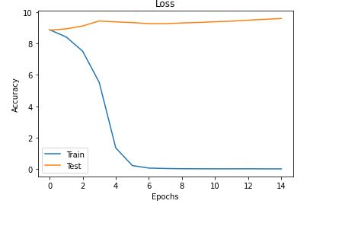
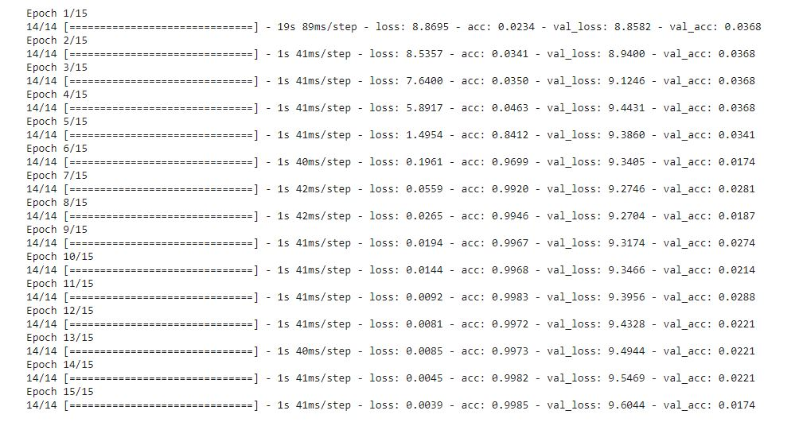
Model setup and results

Slide 7
Srikanth contribution to the project:
Using BOW words created dataset by Irfan
Cosine Similarity for recommendation

Slide 8
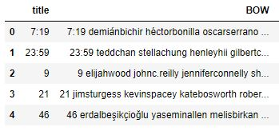
NETFLIX MOVIE RECOMMENDATION USING COSINE SIMILARITY
Preprocessed Data of Netflix titles csv
The BOW column contains combination of title and description column in lower case.
Two columns are combined to make search more efficient based on title as well as description column.

Slide 9
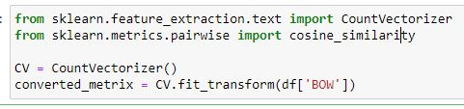
Cosine similarity model is used for training the data and getting recommendations.
Cosine Similarity calculates the similarity between two things.
After computing the similarity, we further use those computed values for recommendations.

Slide 10
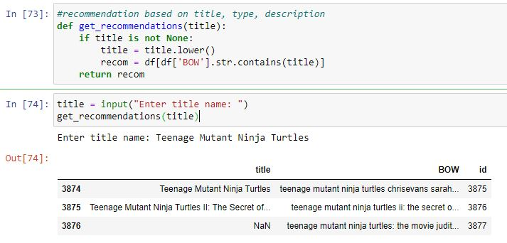
We pass the title and get all the recommendations that matches the title
After taking the input from the user the input is converted to lower case to make search more efficient.
Each row of BOW checks if the input string is present in that column and returns matching rows of that title.

Slide 11
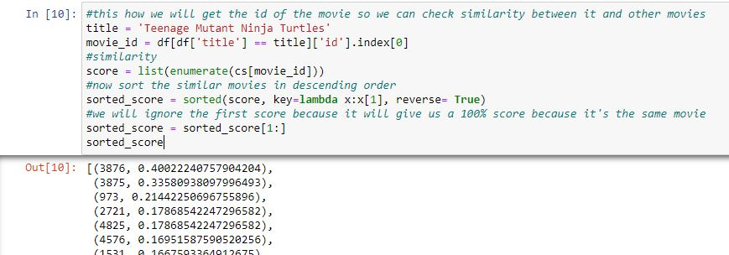
Once the data is trained, we pass the title to the model and will get all the similar movie ids related to the title and the accuracy of movie ids with respect to the title given as an input.

Slide 12
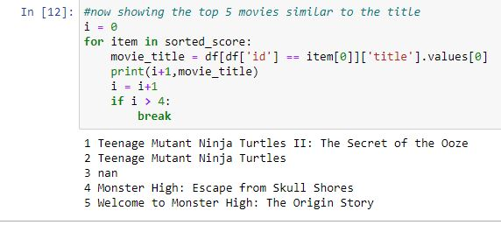
After getting similar movie ids for the title, we now get the movie titles for the recommended ids.

Slide 13
Divyanshi Kothari ‘s Contribution:
TF-IDF Technique
Using Sigmoid Kernal Recommendation Model

Slide 14
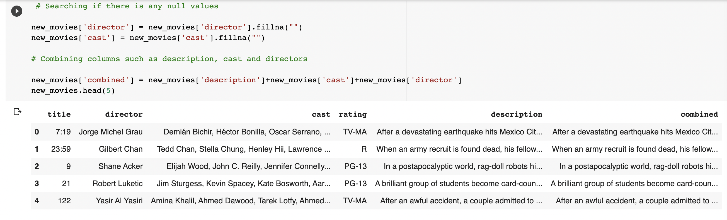
Sigmoid Kernal Recommendation Model
Here the Netflix data is taken and is cleaned
The unnecessary columns like duration, country, year released.. Are removed.
Here Description Cast and Director are combined to get best accurate results.

Slide 15
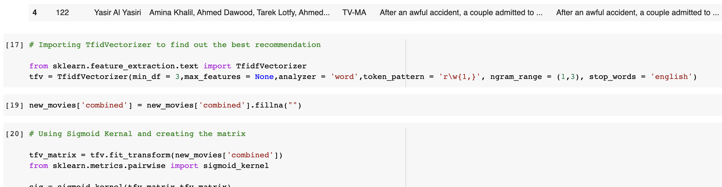
Sigmoid Kernal Recommendation Model
Here the TFIDF which is Term Frequency- Inverse Document Frequency, Vectorizer is imported
If Using TFIDF, the stop words are identified and is removed by the model

Slide 16
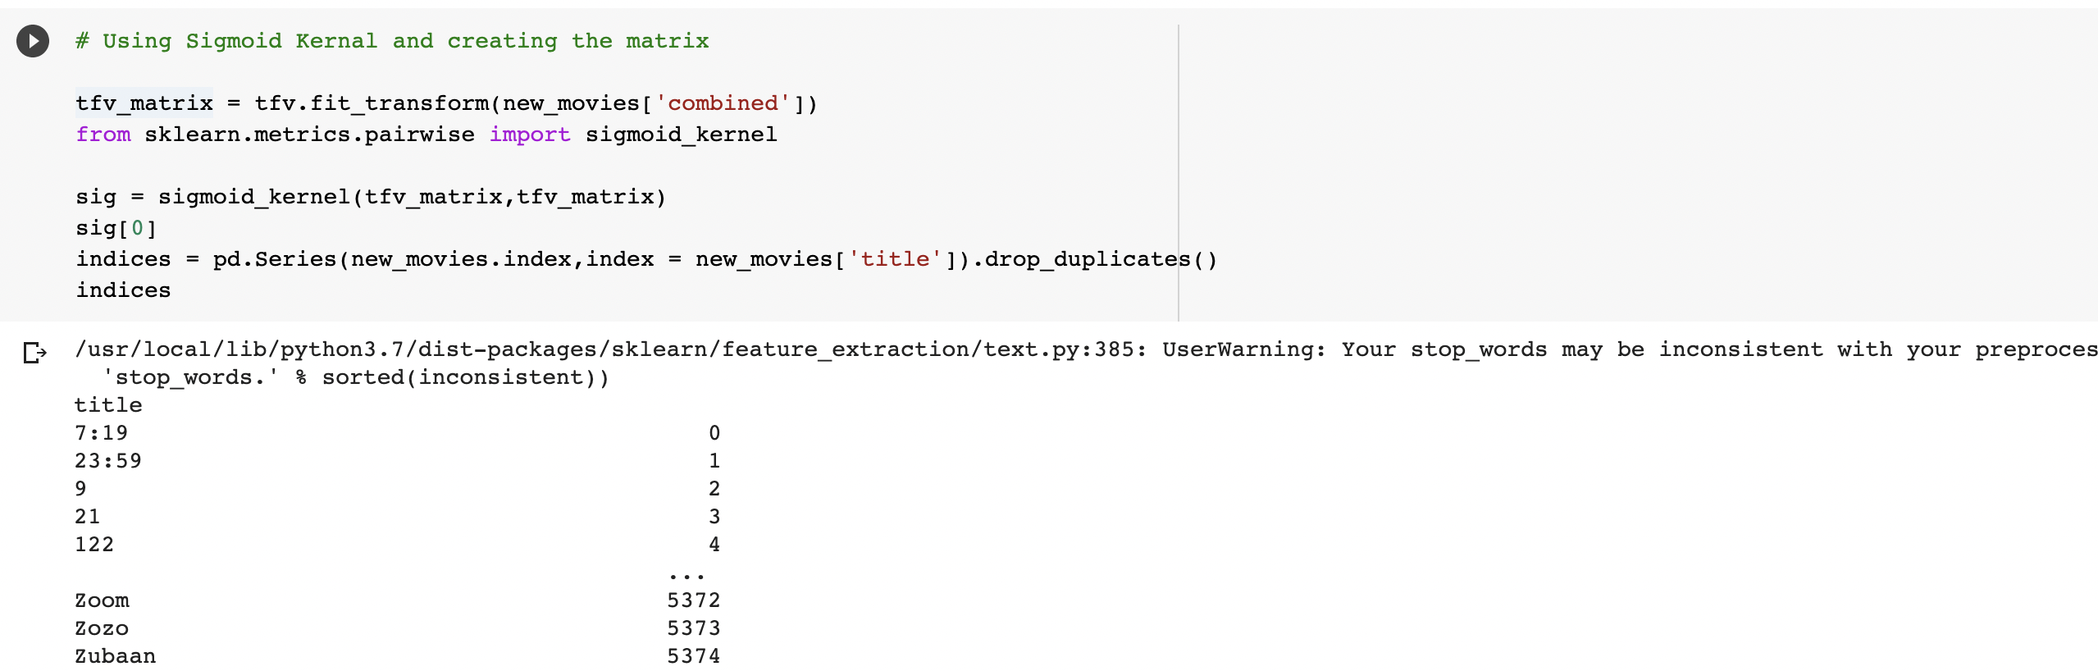
Sigmoid Kernal Recommendation Model
We have used the combined data and used transformation on it
Any duplicated words are dropped and removed
All the words and their counts are then printed to check

Slide 17
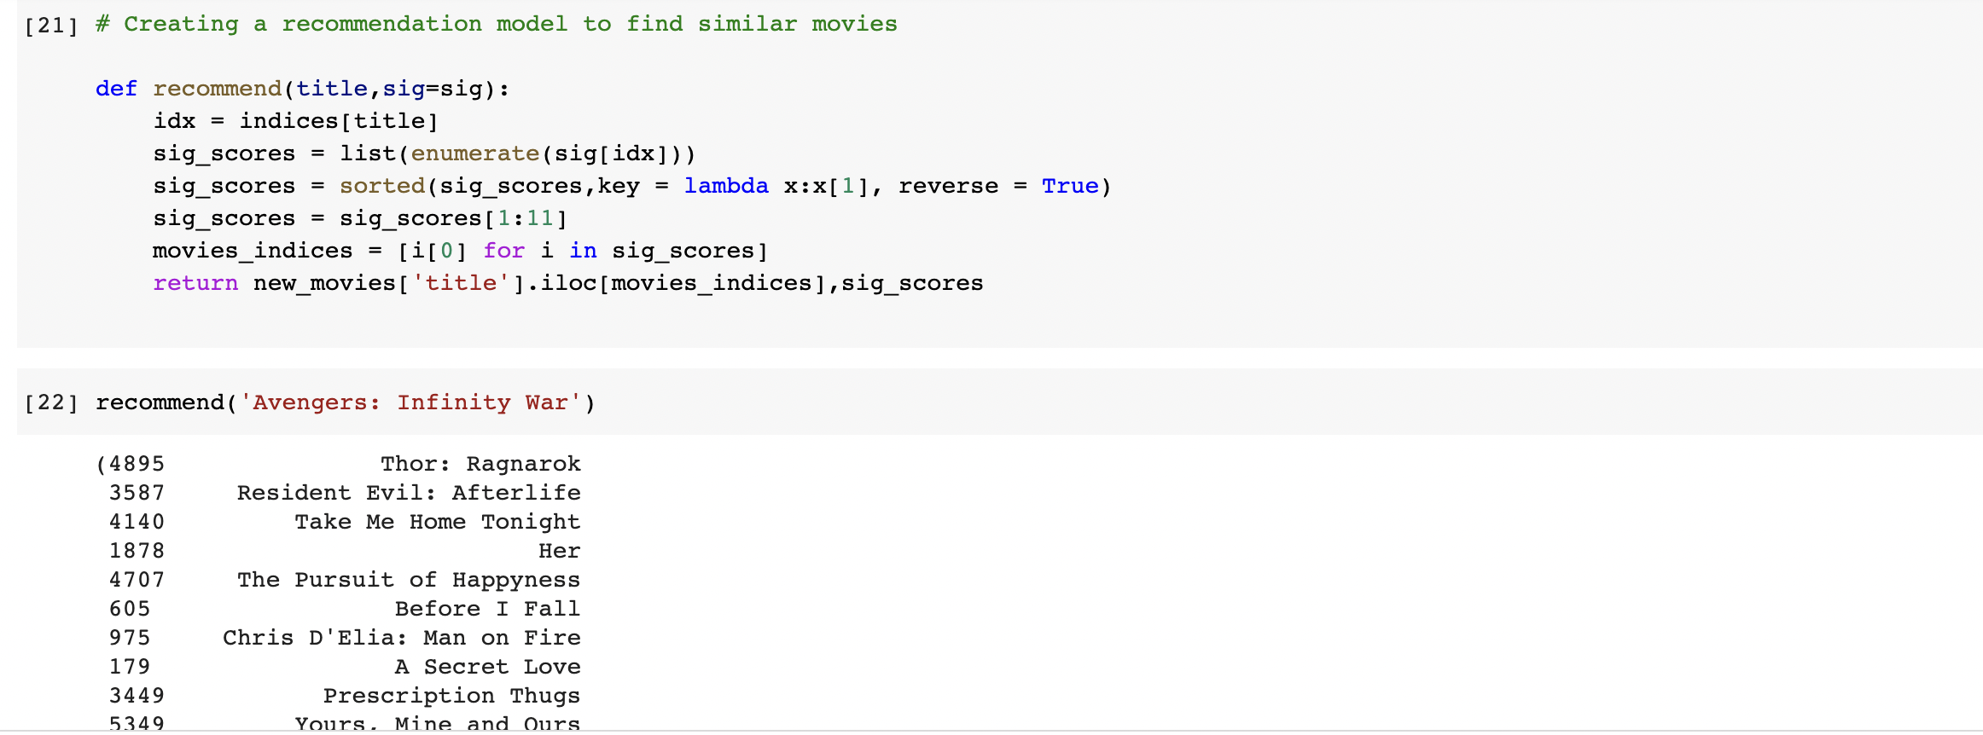
Sigmoid Kernal Recommendation Model
Now with the words that are obtained, a recommendation model is defined
Here the list id enumerated and sorted with the scores of hoe accurate the recommendation would be
With the indices and scores, using a loop the kernel model recommendation movies are printed

Slide 18
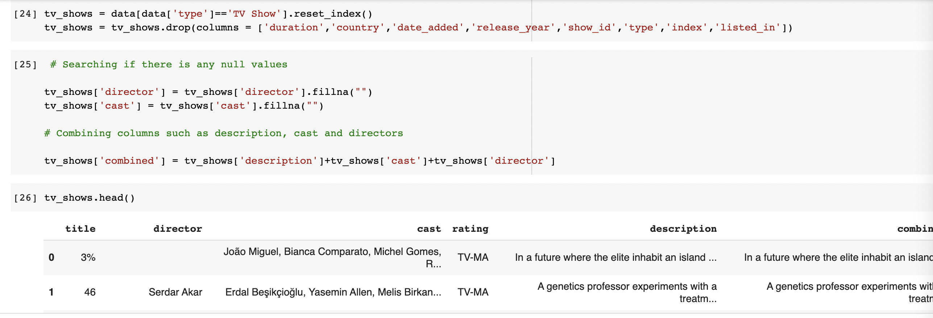
Sigmoid Kernal Recommendation Model for TV Shows
Here the recommendation model is performed for the TV Series as well.
Here the data type is TV Show
Here the unnecessary columns are dropped and description, cast and director are combined.

Slide 19
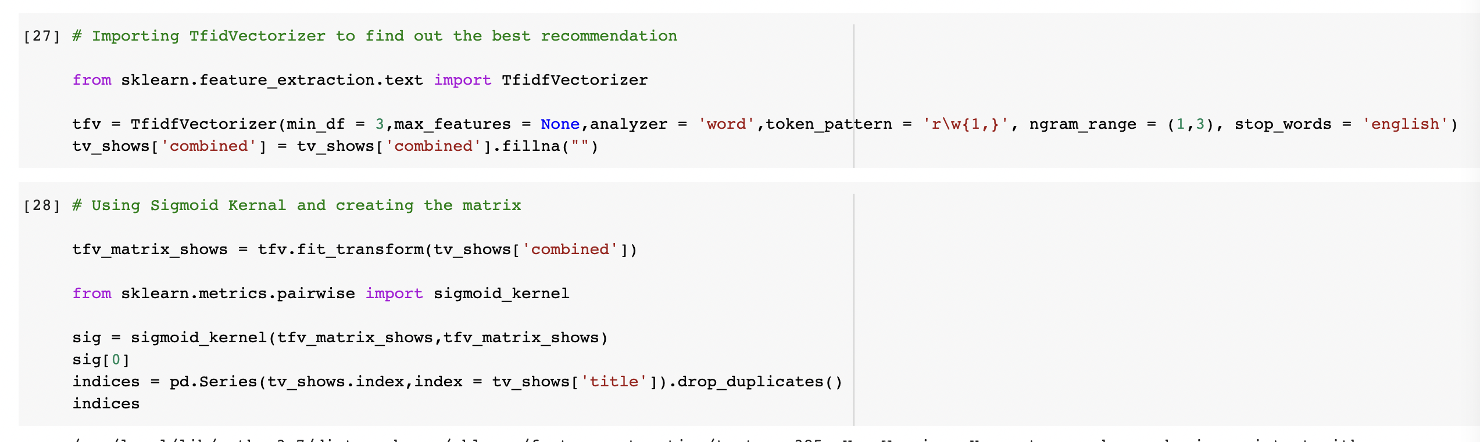
Sigmoid Kernal Recommendation Model for TV Shows
Here the TFIDF which is Term Frequency- Inverse Document Frequency, Vectorizer is imported
If Using TFIDF, the stop words are identified and is removed by the model
Any duplicated words are dropped and removed
All the words and their counts are then printed to check

Slide 20
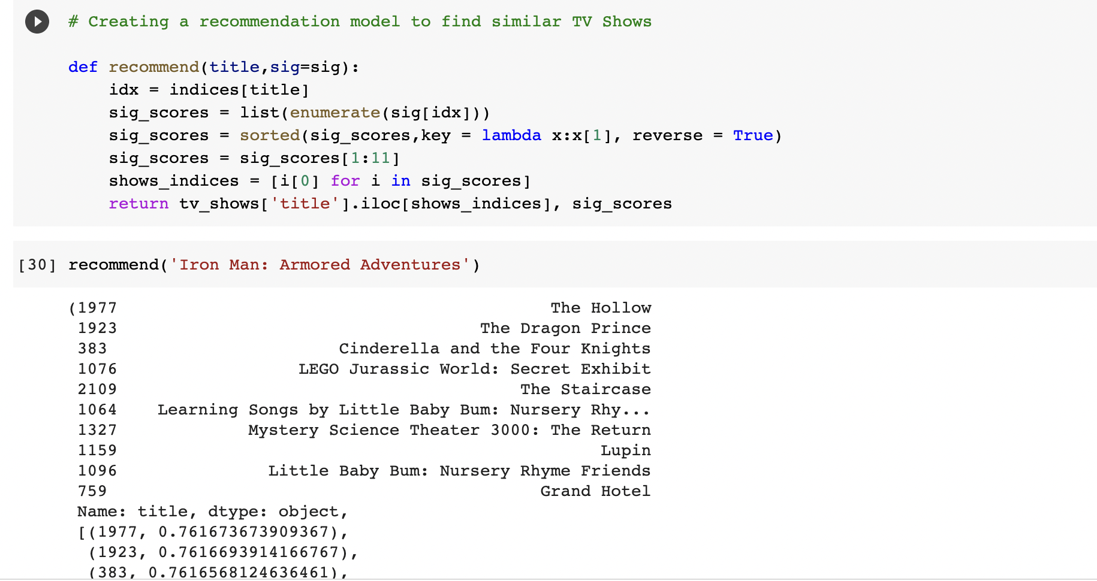
Sigmoid Kernal Recommendation Model for TV Shows
Now with the words that are obtained, a recommendation model is defined
Here the list id enumerated and sorted with the scores of hoe accurate the recommendation would be
With the indices and scores, using a loop the kernel model recommendation series are printed

Slide 21
References
https://www.kaggle.com/shivamb/netflix-shows
Class PowerPoints

